Slide 1
Region Processing II
Prof. Eric Miller
elmiller@ece.tufts.edu
Fall 2009
EN 74-ECE Image Processing
Lecture 6-<number>

Slide 2
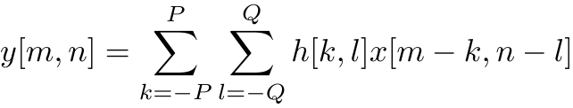
The 2D Case
Column: n
1 2 3 4 5 ….. N
Column: q
1
x[1,2]
-Q … 0 …. Q
2
-P
3
…
0
h[0,0]
Row: p
Row: m
x[m,n]
…
…
P
Much like before but with two variables
We stick with odd-sized filters using above index system
We stick with images with above index system
Only concerned with y[m,n] for m=1,2,…M and n = 1,2,…,N
M
x[M,3]
Fall 2009
EN 74-ECE Image Processing
Lecture 6-<number>

Slide 3
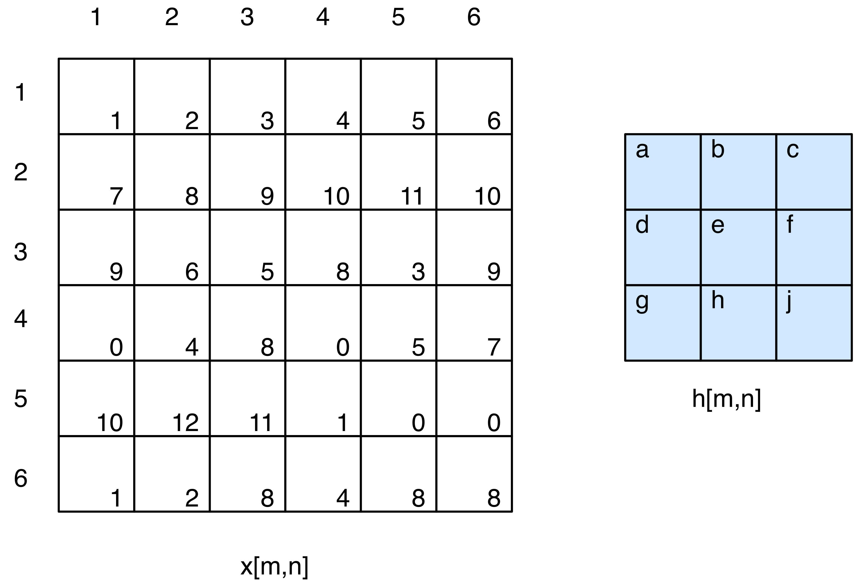
Example
Output image will be of size 6 by 6
Basically we replace each pixel in x by an weighted average of that pixel and its neighbors
When h spills over the edge, we assume x is zero
Fall 2009
EN 74-ECE Image Processing
Lecture 6-<number>

Slide 4
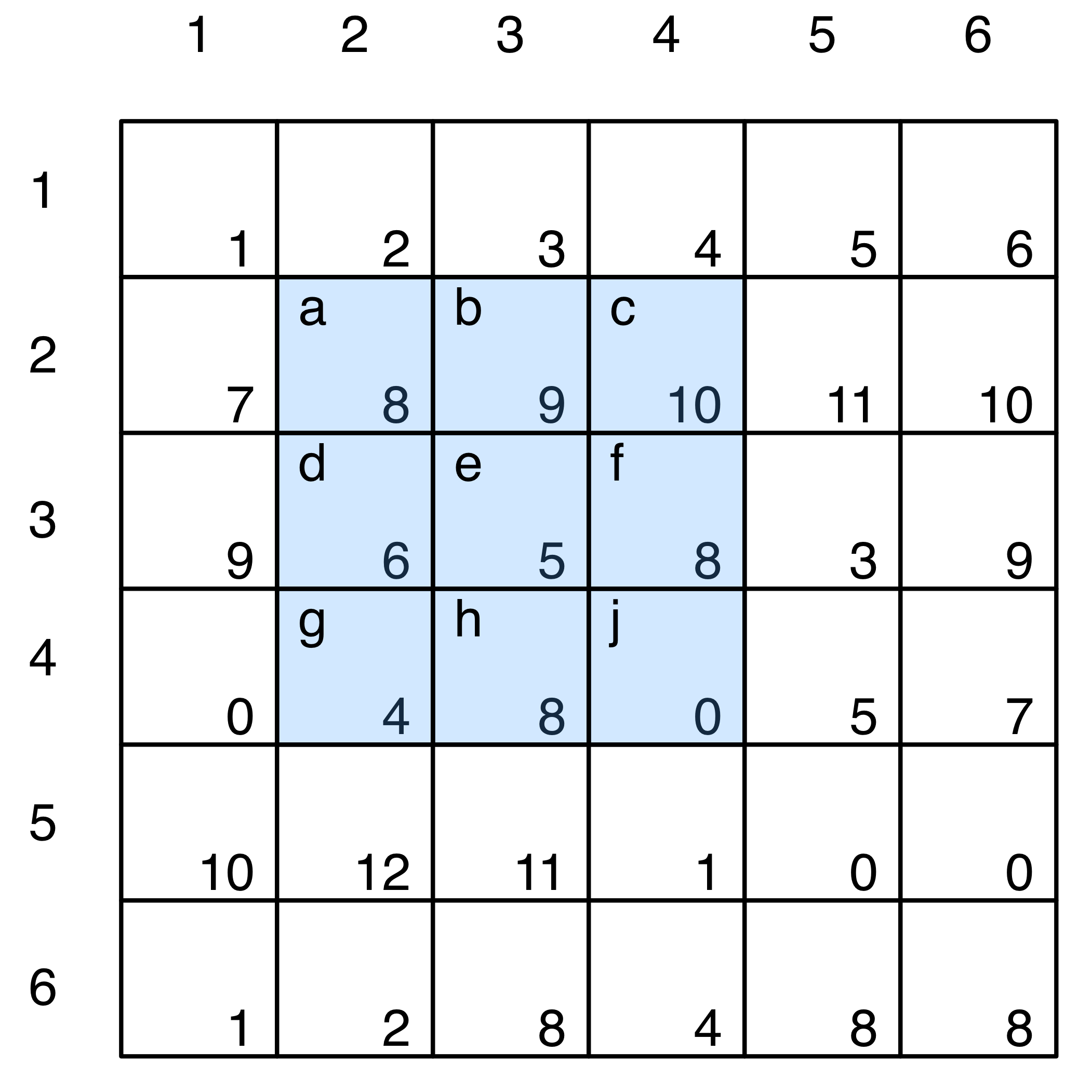
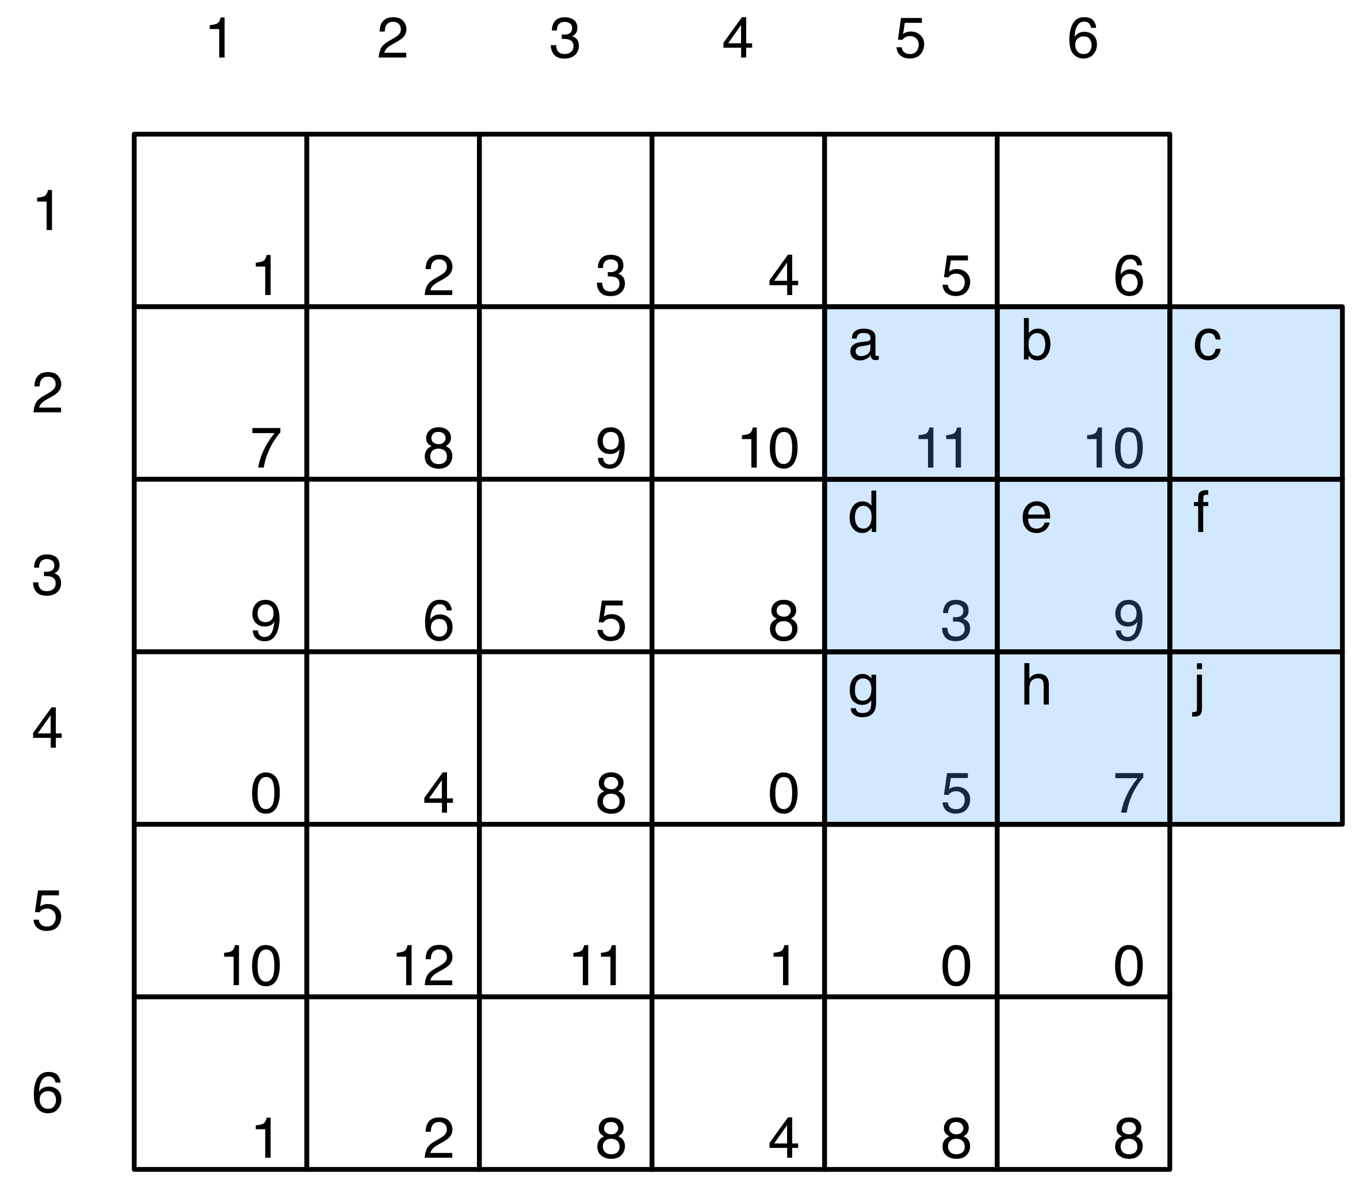
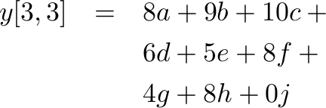
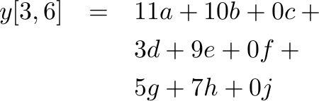
Example (cont)
Fall 2009
EN 74-ECE Image Processing
Lecture 6-<number>

Slide 5
Implementation
Not hard to implement this, but a bit tedious. We will use the Matlab function filter2
y = filter2(h,x,shape)
h and x are the filter and the image as we would expect
shape = ‘same’ or ‘valid’ or ‘full’
  same = y same size as x
  valid = all pixels not impacted by edges (y smaller than x)
  full = any overlap of filter with image (y larger than x)
Fall 2009
EN 74-ECE Image Processing
Lecture 6-<number>

Slide 6
What can we do with this
People have built filters to “do” common things
  Smooth images to removing detail or getting rid of noise
  Enhancing features especially horizontal and vertical edges
We’ll stick with these two
Fall 2009
EN 74-ECE Image Processing
Lecture 6-<number>

Slide 7
Image smoothing
Many types of smoothing filters especially for 1D problems
For images: consider a couple of common choices
  Boxes: arithmetic averager
  Gaussian: bell curve in 2D
Fall 2009
EN 74-ECE Image Processing
Lecture 6-<number>

Slide 8
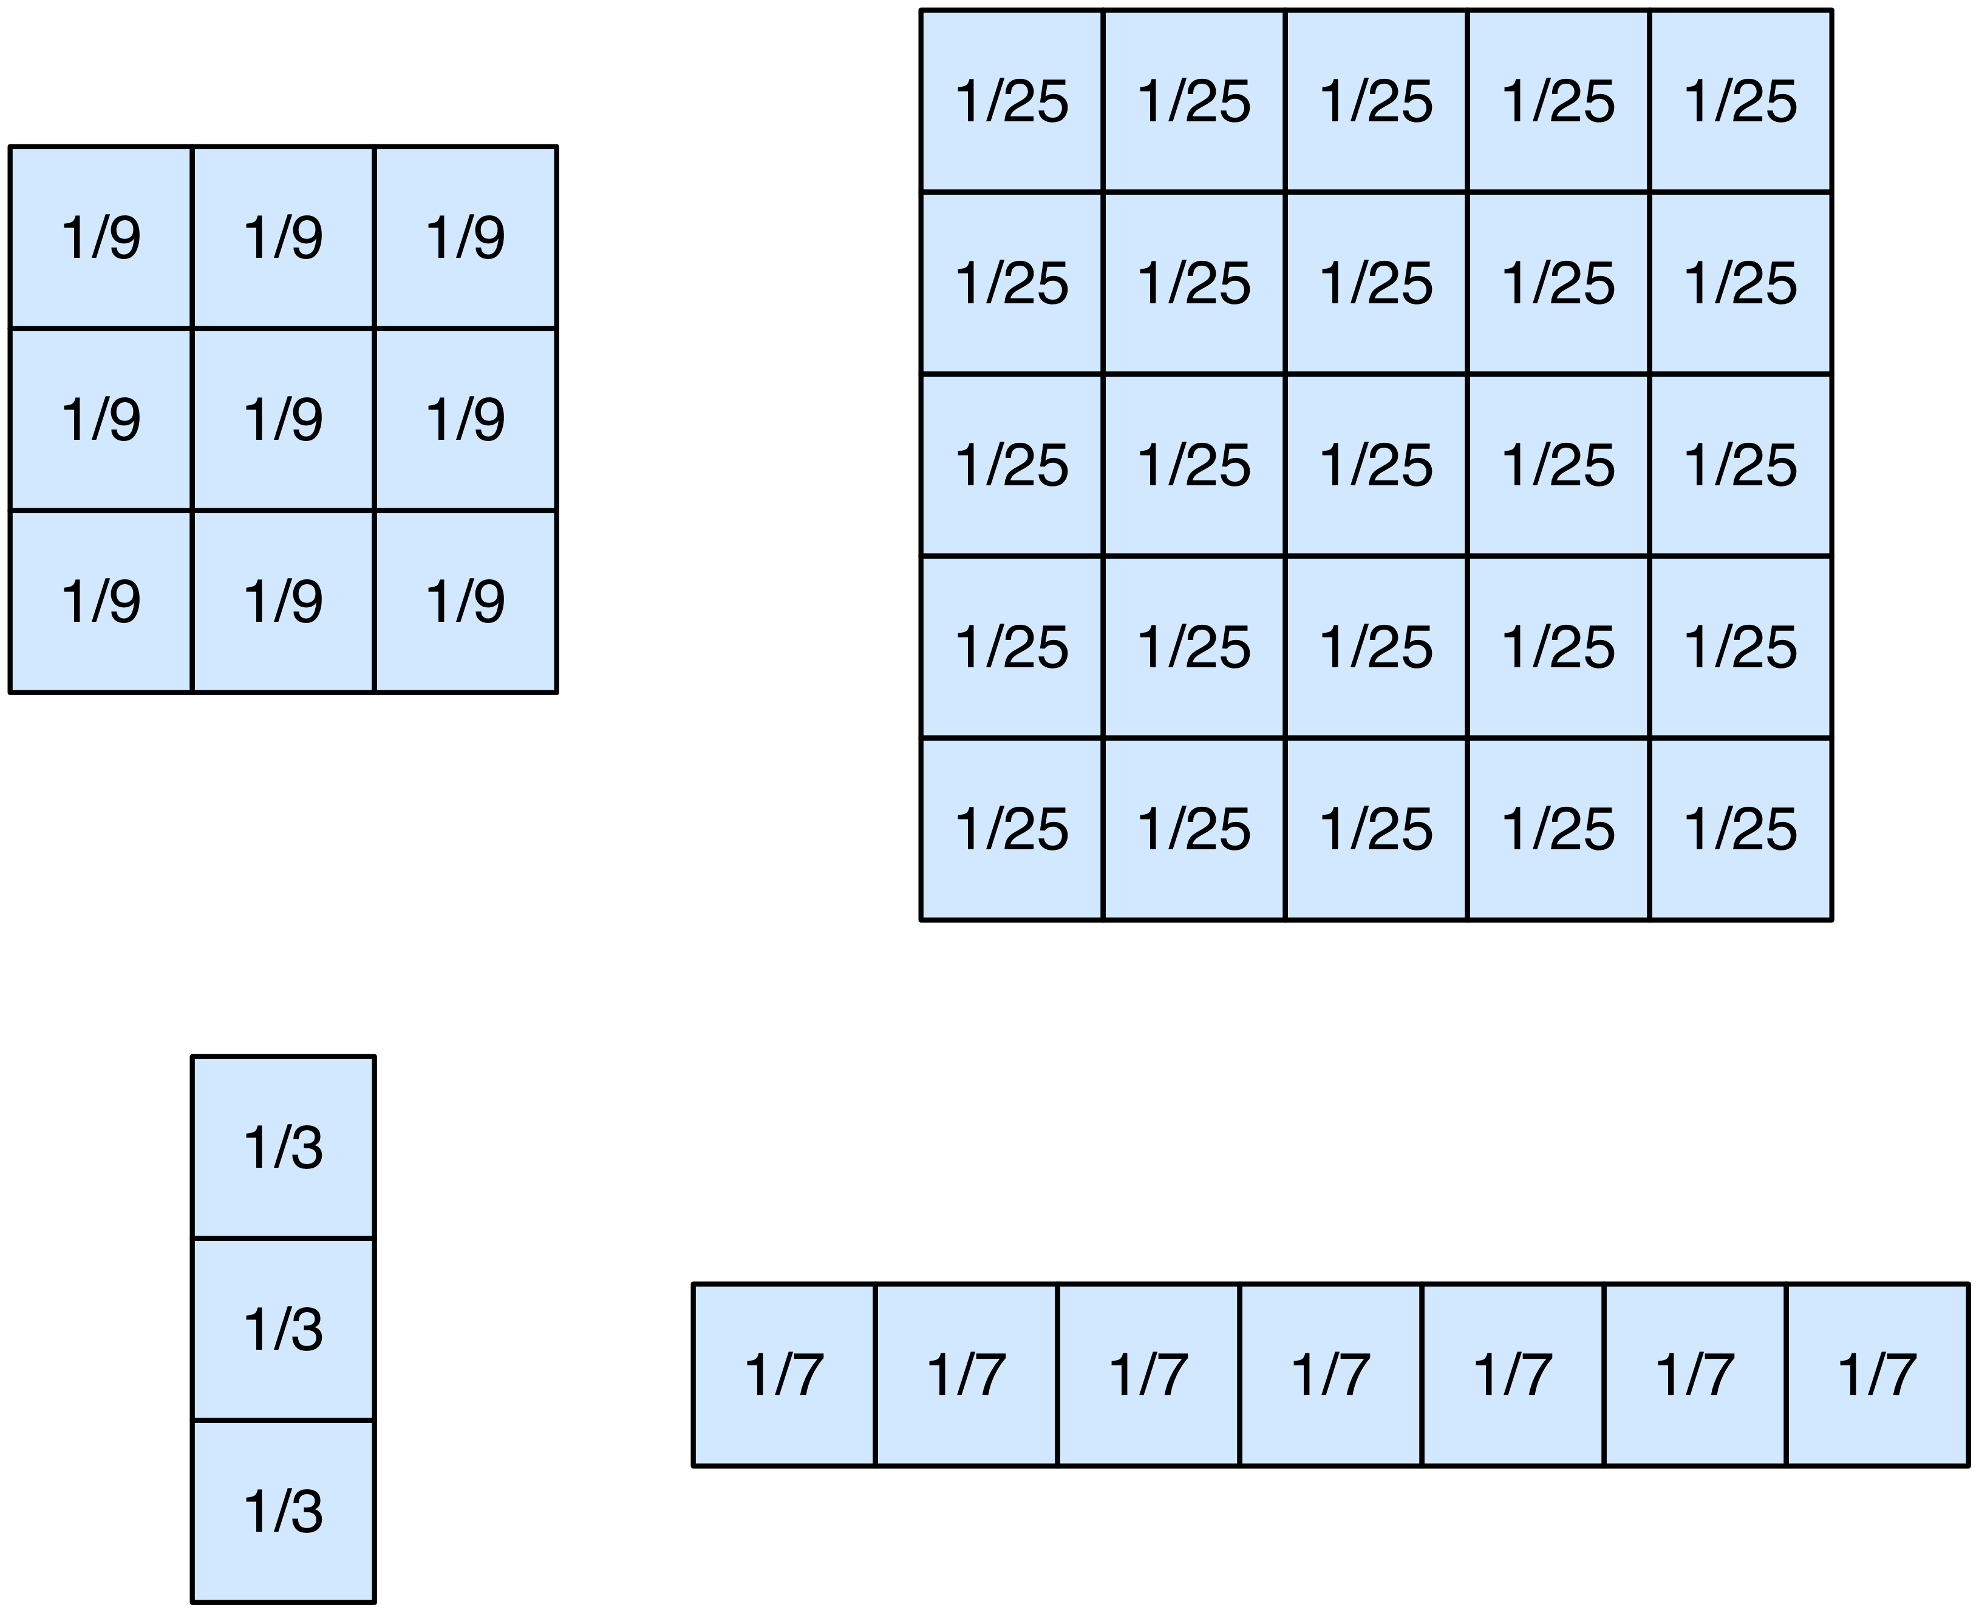
Box filters
h[m,n] = 1/N where there are N pixels in h
What might each of these do?
Matlab construction:
h = fspecial(‘average’,[M,N]);
creates an MxN averaging filter
Fall 2009
EN 74-ECE Image Processing
Lecture 6-<number>

Slide 9

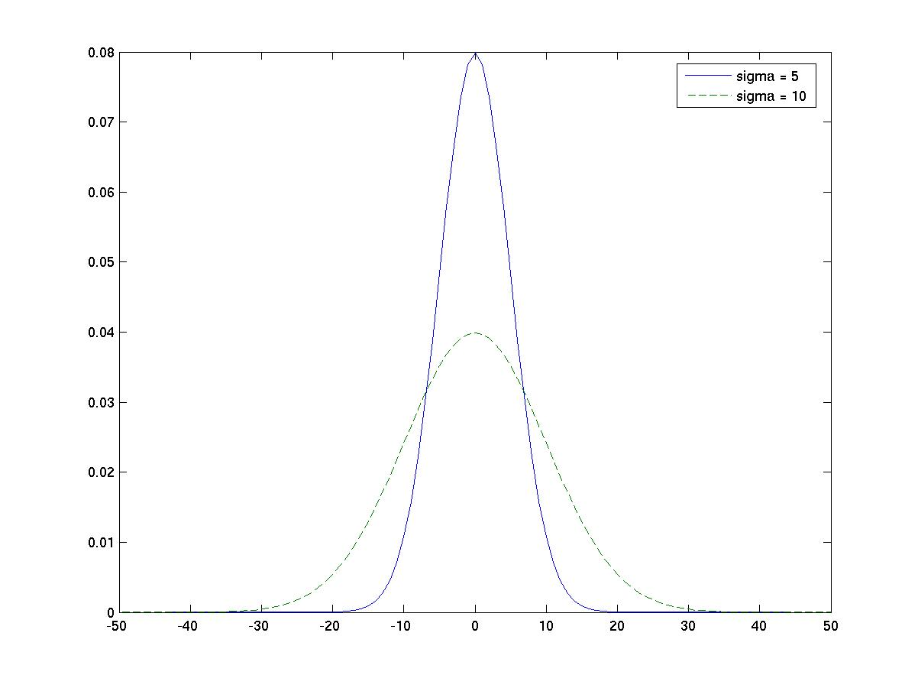
Gaussian in 1D
n = -50:50;
sigma = 3;
h = exp(-n.^2/(2*sigma*sigma));
C = 1/sum(h); h = c*h;
C chosen to make h have area = 1
Note role of σ in defining the width of the filter
Not a uniform average. Closer points get more weight
Many filters have similar characteristics. This one is special for reasons a bit beyond this class.
Fall 2009
EN 74-ECE Image Processing
Lecture 6-<number>

Slide 10

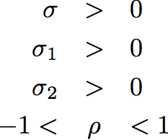


Gaussian in 2D
Simplest case
In all cases
A bit more general
The most general
Fall 2009
EN 74-ECE Image Processing
Lecture 6-<number>

Slide 11
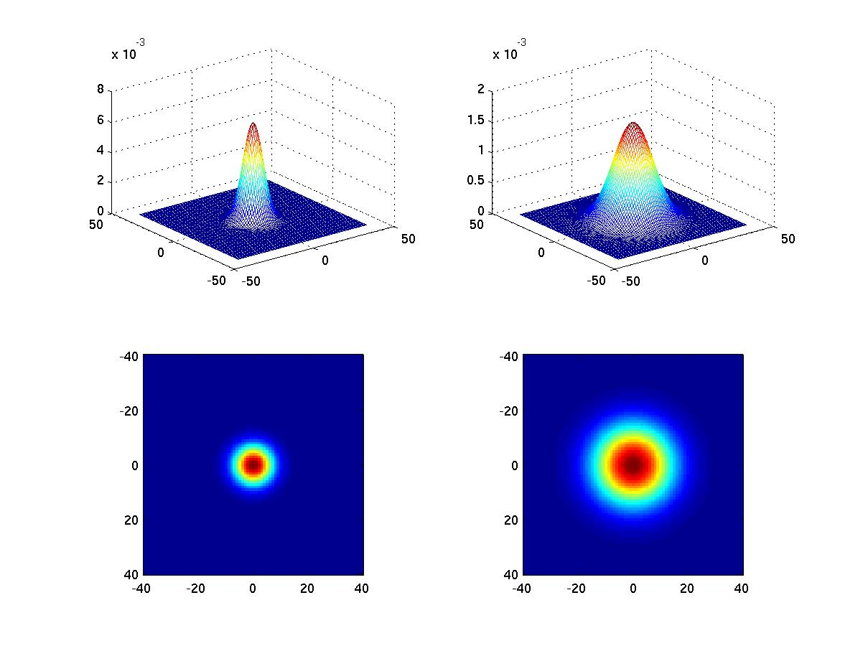
Look at simple Gaussian
Circularly symmetric also called “isotropic” in EE-speak means all directions treated the same
Note the role of σ in defining the width of the filter; how much averaging takes place
Fall 2009
EN 74-ECE Image Processing
Lecture 6-<number>

Slide 12
Matlab Topics
Use of meshgrid for generating sets of 2D points
Use of fspecial for building filters
Use of mesh for displaying surfaces and imagesc as an alternate for imshow for displaying pictures
Fall 2009
EN 74-ECE Image Processing
Lecture 6-<number>

